Slide 1

Spotify Analysis on Turkish Music
Umre Metin
Mina Silahtaroğlu

Slide 2
What we have done before:
Data Exploration
For the top artists, looked for the correlation between the top songs’ attributes and “danceability”
Plotted the top songs’ danceability
Looked for the most positive songs
Plotted the valences of albums

Slide 3

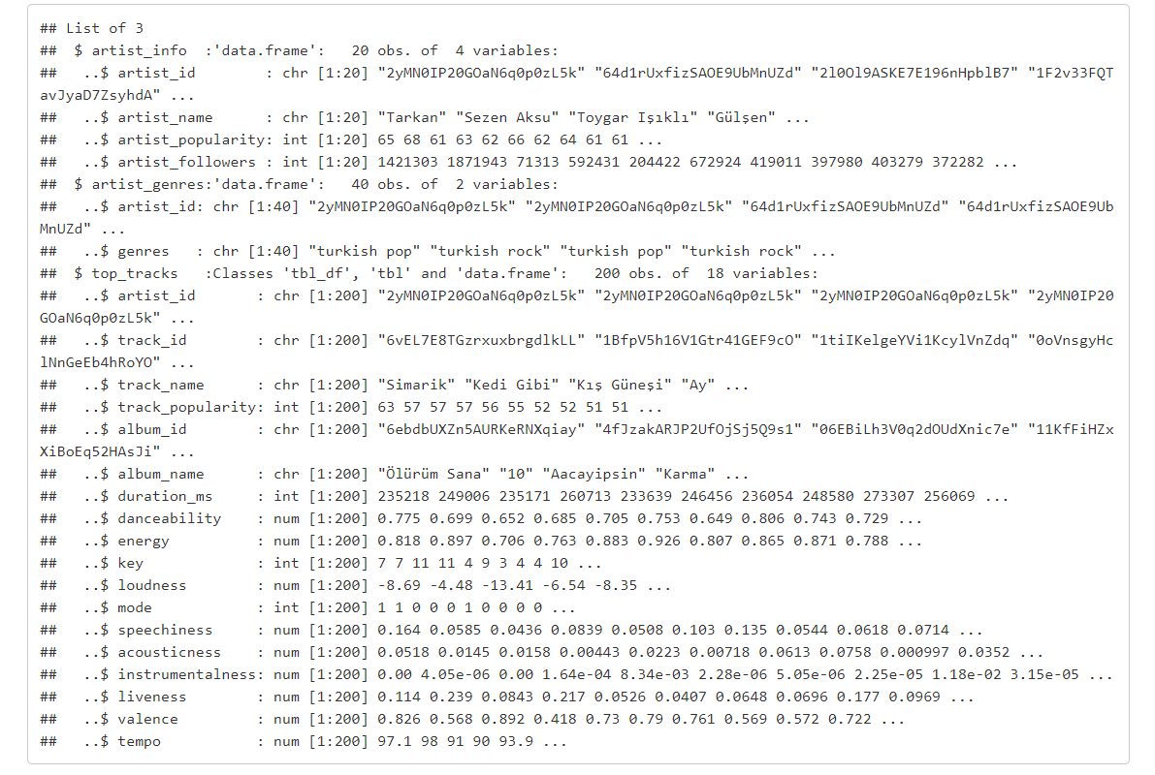

Slide 4
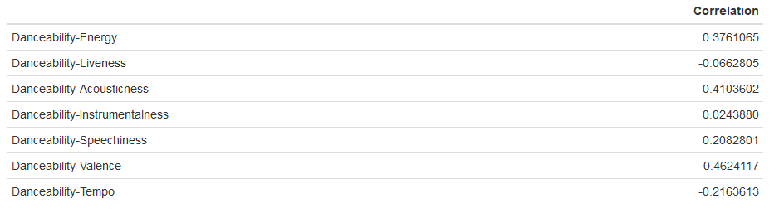

Slide 5
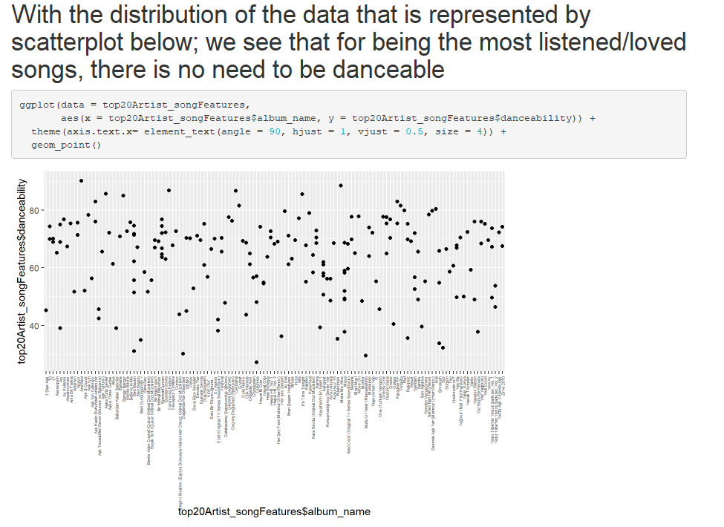

Slide 6
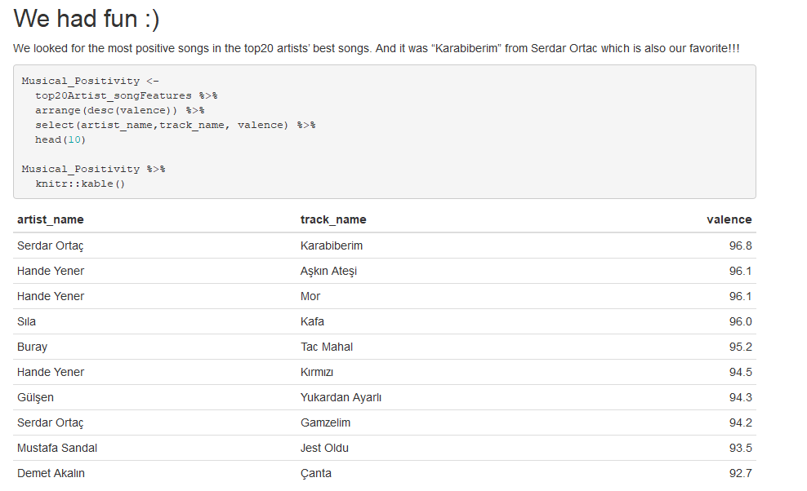

Slide 7
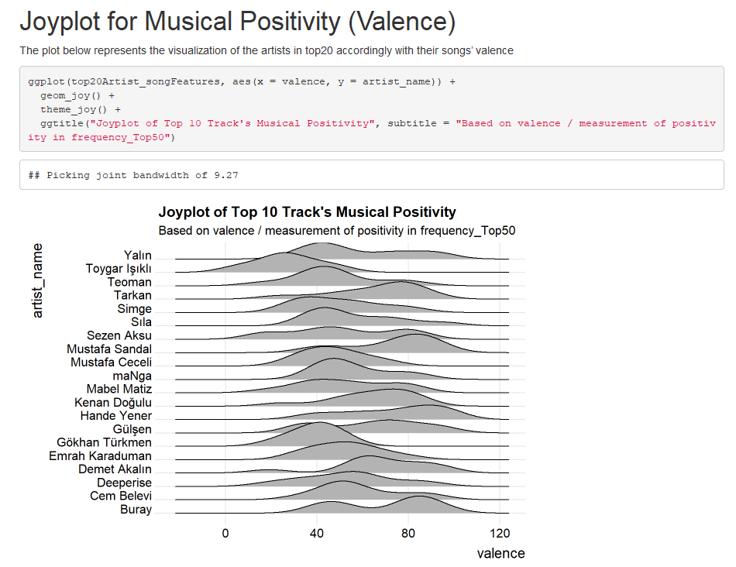

Slide 8
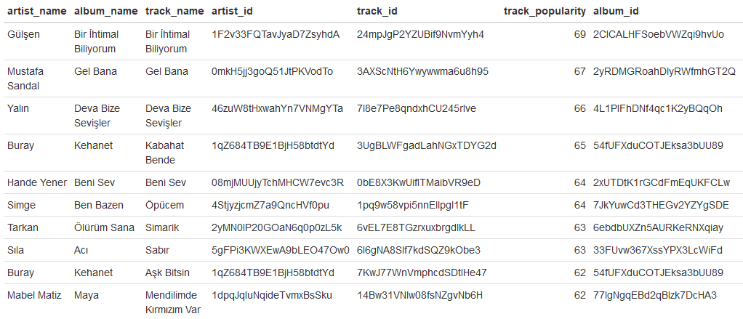

Slide 9
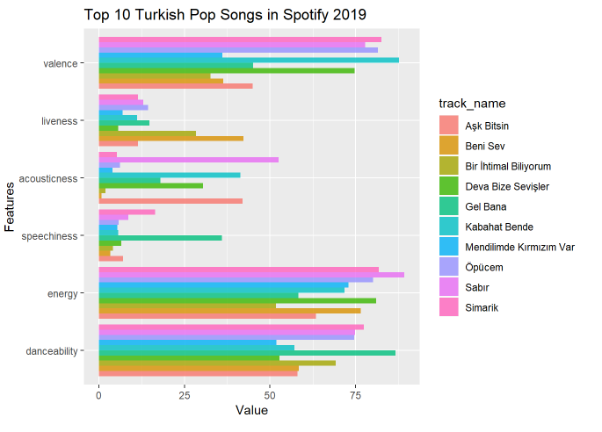

Slide 10
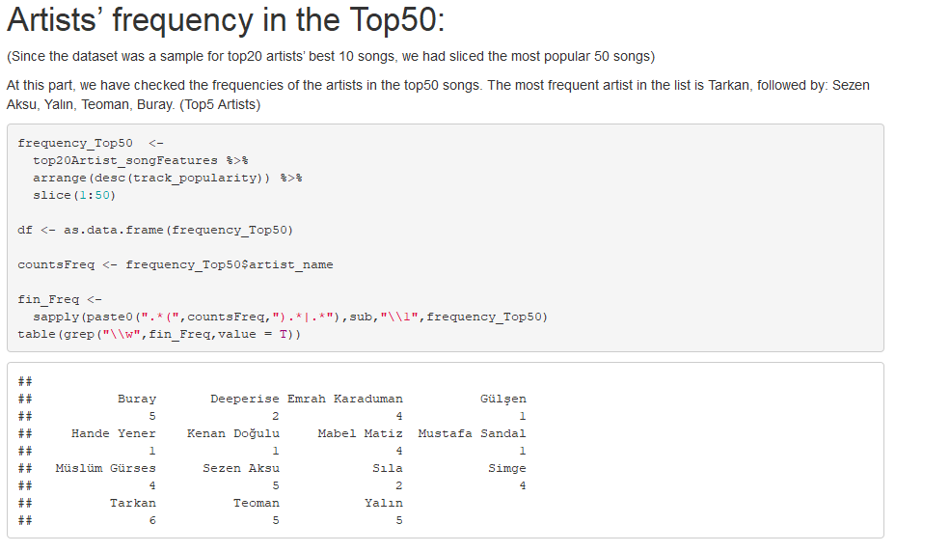

Slide 11
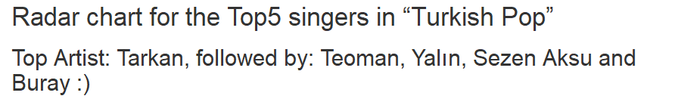
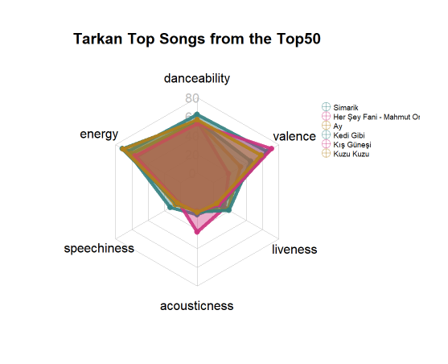
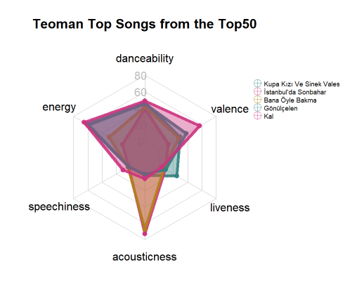

Slide 12
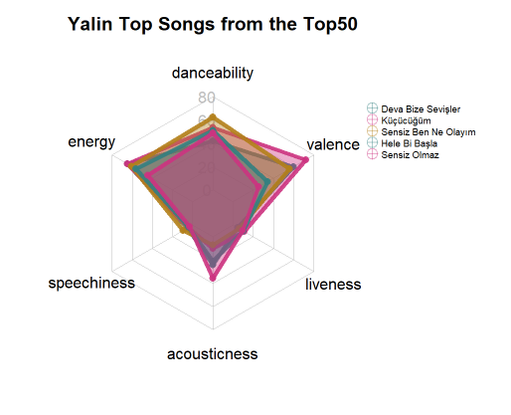
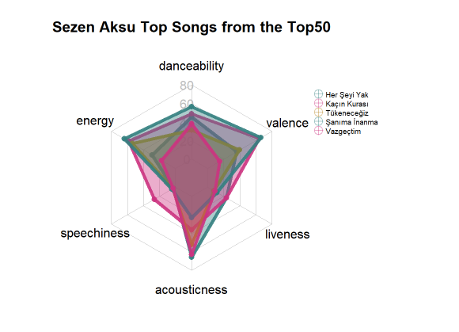

Slide 13
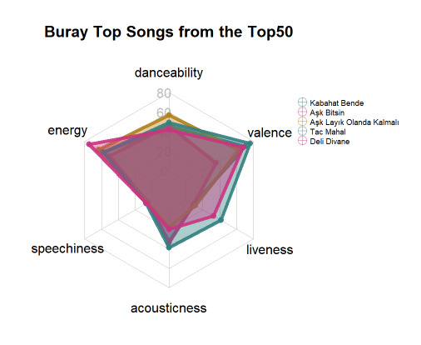

Slide 14
KEY EMOTIONS
C major :Innocently Happy
C minor :Innocently Sad, Love-Sick
C sharp minor : Despair, Wailing, Weeping
C sharp major: fullness, sonorousness, euphony
D major: Triumphant, Victorious War-Cries
D minor: Serious, Pious, Ruminating
D sharp minor: Deep Distress, Existential Angst
D sharp major: Cruel, Hard, Yet Full of Devotion
E major: Quarrelsome, Boisterous, Incomplete Pleasure
E minor: Effeminate, Amorous, Restless
F major: Complaisance and calm
E sharp minor: Obscure, Plaintive, Funereal
F sharp major : Conquering Difficulties, Sighs of Relief
F sharp minor: Gloomy, Passionate Resentment
G major: Serious, Magnificent, Fantasy
G minor: Discontent, Uneasiness
G sharp major : Death, Eternity, Judgement
G sharp minor : Grumbling, Moaning, Wailing
A major : Joyful, Pastoral, Declaration of Love
A minor : Tender, Plaintive, Pious
A sharp major: Joyful, Quaint, Cheerful
Bflat minor : Terrible, the Night, Mocking
B major: Harsh, Strong, Wild, Rage
B minor: Solitary, Melancholic, Patience

Slide 15
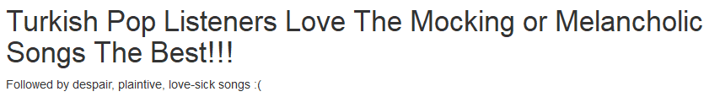
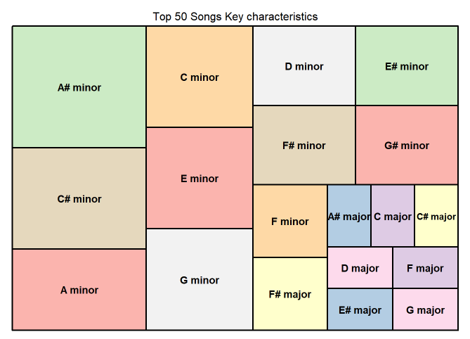

Slide 16
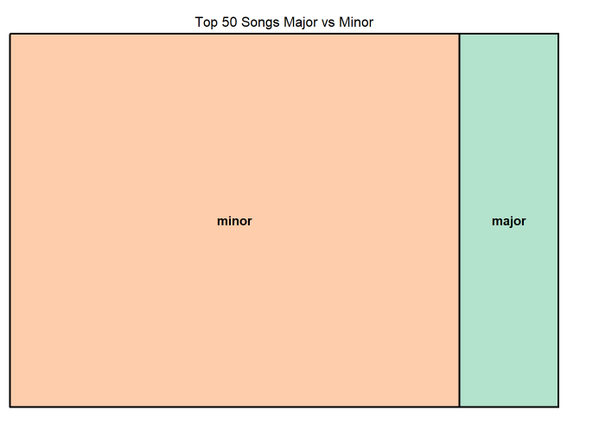

Slide 17
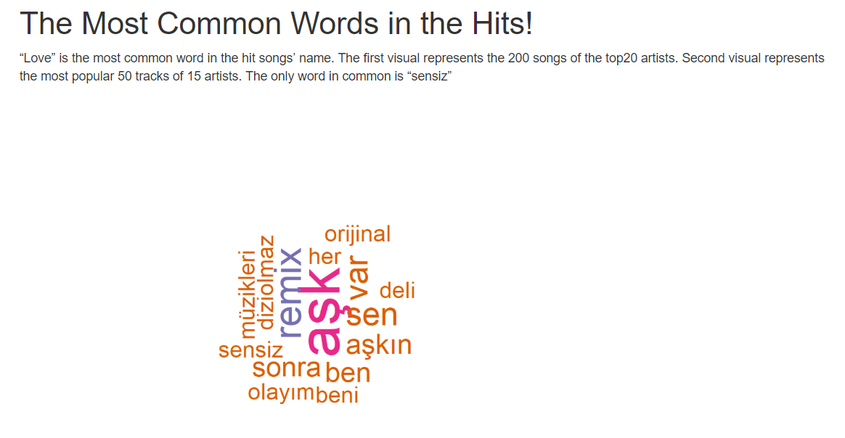


Slide 18
What will be done:
Tempo analysis, heatmap
Function generalization
K-means
Shiny

